Slide 1
Freelancer Marking PlantForm
Presentad By: Group-6
K.TejaSree AP23110011434
G.Yamini AP23110011448
G.Mohana Krishna AP23110011462
R.Lohitha AP23110011469
K.Sri Poojitha AP23110011640
Ch.Ashwini AP23110011647

Slide 2
The Challenge in Freelancing
Talent Discovery Gap
Clients can't easily find the right freelancer. The search process is fragmented across multiple platforms with no unified skill verification.
No Skill Building Paths
Freelancers lack structured skill-building paths. There's no clear progression from beginner to expert with verified credentials.
Fragmented Platform Ecosystem
No single platform combining jobs, internships & learning. Freelancers must juggle multiple tools and websites to manage their career.
Inefficient Communication & Payments
Inefficient communication and payment tracking. Disputes arise from unclear milestones and lack of transparent payment systems.
2

Slide 3
6 Core Features
Smart Project Matching
Marketplace
Internship Portal
AI skill-based freelancer recommendations that match the right talent to the right project automatically.
Browse and apply to projects with advanced filters for skills, budget, and category preferences.
Students apply to internship opportunities and gain real-world experience while building their portfolio.
Learning Paths
Real-Time Chat
Reviews and Ratings
Courses, quizzes, progress tracking and certificates to help freelancers upskill continuously.
Project-based messaging between clients and freelancers for seamless collaboration.
Clients and freelancers can rate and review each other based on project experience, ensuring trust, quality, and transparency on the platform.
4

Slide 4
Tech Stack
Our tech stack is designed for scalability, performance, and seamless user experience across the platform.
Frontend
Backend
Database
React + Vite + Tailwind CSS
Node.js + Express
MongoDB with Mongoose
Smart Matching
AI-powered recommendations
Real-Time Chat
Instant communication
Learning Paths
Skill development courses
3

Slide 5
Tech Stack
Frontend & Backend
Services & Dev Tools
React — UI library for component-based frontend
Resume Parser — Automated skill extraction
Vite — Fast build tool and dev server
Badge Engine — Certificate & credential system
Tailwind CSS — Utility-first CSS framework
Vite Proxy — Development proxy configuration
Node.js — JavaScript runtime for backend
ES Modules — Modern JavaScript modules
Express.js — REST API framework
npm Workspaces — Monorepo package management
MongoDB — NoSQL database with Mongoose
5

Slide 6
System Architecture
Browser
React Frontend
Express Backend
MongoDB
Vite :5173
:5000
Backend Modules
Auth
Projects
Internships
Chat
Payments
Courses
Reviews
The frontend communicates with the backend via REST APIs. The backend uses Mongoose models for MongoDB operations and a JSON store for demo data. All modules are independently deployable microservices.
6

Slide 7
User Roles
CLIENT
FREELANCER
Admin
Manage Users
Monitor client and freelancer accounts, verify profiles, and handle account approvals or restrictions.
Add & Manage Courses
Create, update, and organize learning content to help freelancers upskill continuously.
Add Certifications
Provide verified certifications for completed courses to enhance freelancer credibility.
Handle Issues & Support
Resolve user complaints, manage disputes, and ensure smooth platform operations.
Post projects with budget & skill tags to attract the right talent
Browse & apply to matching projects with smart recommendations
Review and shortlist freelancer applications with skill matching
Showcase skills, ratings & portfolio to stand out to clients
Track milestones and project progress in real-time dashboards
Complete courses and earn verified certificates
Release payments securely through Razorpay integration
Chat with clients in real time for seamless collaboration
7

Slide 8
Platform Modules
Authentication
Dashboard
Marketplace
Secure login and registration system with role-based access control for clients and freelancers.
Earnings overview, project statistics, active project tracking and performance analytics.
Browse projects with filters for skill requirements, budget range, and project category.
Smart Matching
Learning Center
Internships
Auto freelancer recommendations based on skills, experience, and project requirements.
Courses, quizzes, progress tracking and certificates for continuous skill development.
Browse, apply and track internship applications with status updates and notifications.
8

Slide 9
Demo Users
Aarav Mehta
CLIENT
HelioScale
Posts web development, design & microsite projects. Looking for skilled freelancers with proven portfolios.
Riya Sharma
Vikram Patel
Neha Iyer
FREELANCER
FREELANCER
FREELANCER
React, Node.js Expert
Figma, UI Design
HTML, CSS, JS Beginner
₹1,85,000
Earned
5
Projects
₹92,000
Earned
2
Projects
₹18,000
Earned
1
Project
Top Rated Freelancer
Rising Talent
New Freelancer
9

Slide 10
Sample Projects
Live Project Listings
IN PROGRESS
SaaS Analytics Dashboard
₹80,000 – ₹1,20,000
React
Node.js
OPEN
Mobile Onboarding Redesign
₹20,000 – ₹35,000
Figma
UI Design
OPEN
Marketing Microsite
₹15,000 – ₹25,000
HTML
CSS
JS
10

Slide 11
Future Roadmap
MongoDB Live
Full database integration
AI Engine
Smart recommendations
Video Calling
In-platform calls
Mobile App
React Native
Escrow Payments
Milestone system
Portfolio Pages
Freelancer showcase
Admin Dashboard
Analytics & insights
Building the Future
Our roadmap focuses on three pillars: Intelligence (AI recommendations, analytics), Accessibility (mobile app, video calls), and Trust (escrow payments, portfolio verification). Each milestone brings us closer to the ultimate freelancer marketplace experience.
11

Slide 12
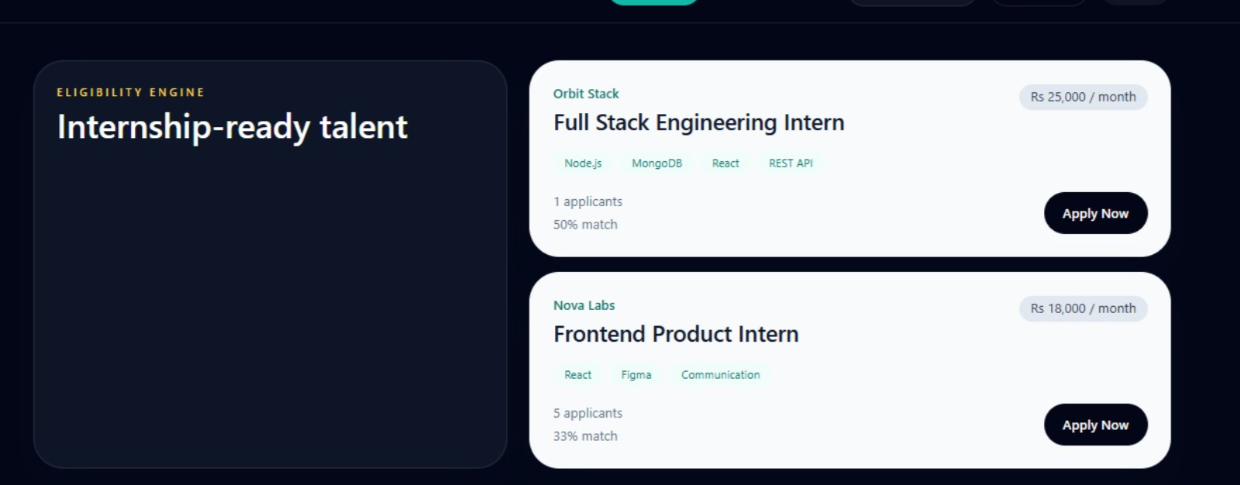
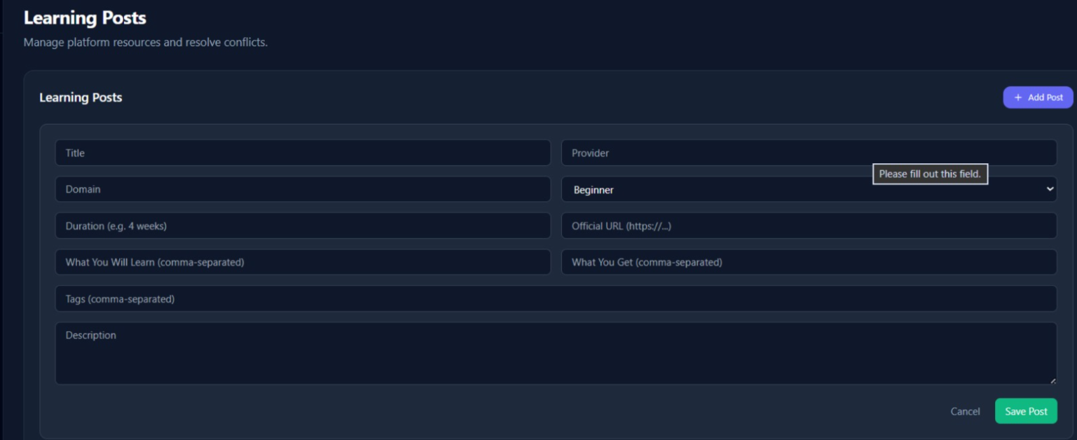
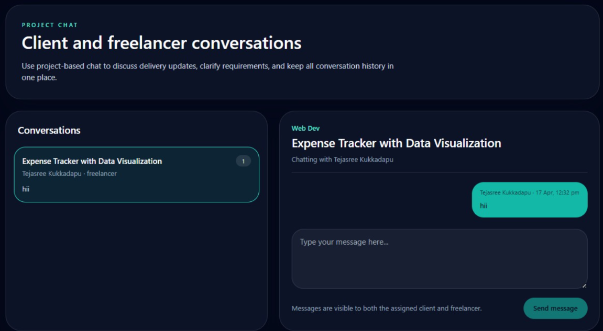
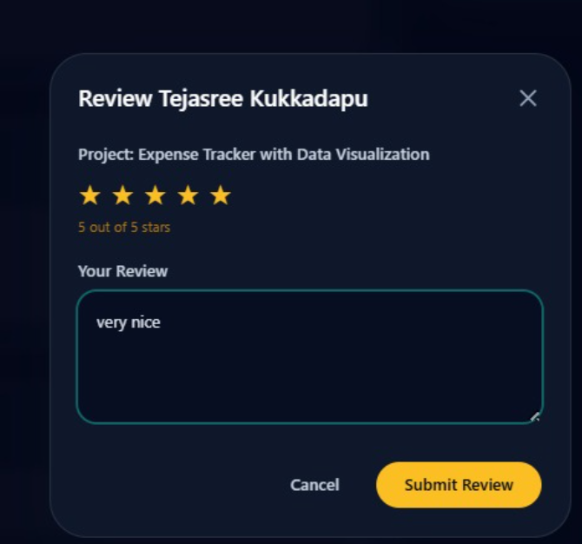
OUTPUTS

Slide 13
Thank You

